Slide 1
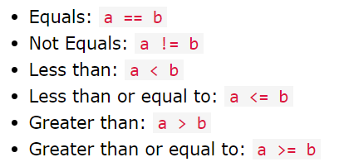
Python If ... Else
Python Conditions and If statements
Python supports the usual logical conditions from mathematics:
These conditions can be used in several ways, most commonly in "if statements" and loops.
An "if statement" is written by using the if keyword.

Slide 2
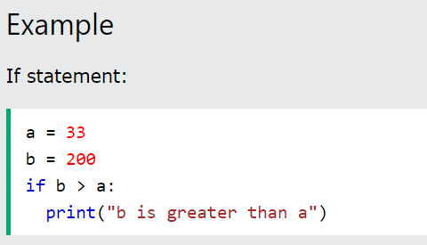
In this example we use two variables, a and b, which are used as part of the if statement to test whether b is greater than a. As a is 33, and b is 200, we know that 200 is greater than 33, and so we print to screen that "b is greater than a".

Slide 3
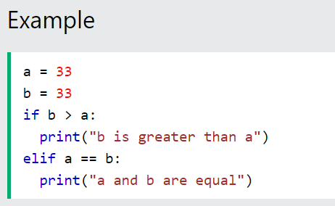
Elif
The elif keyword is pythons way of saying "if the previous conditions were not true, then try this condition".
In this example a is equal to b, so the first condition is not true, but the elif condition is true, so we print to screen that "a and b are equal".

Slide 4
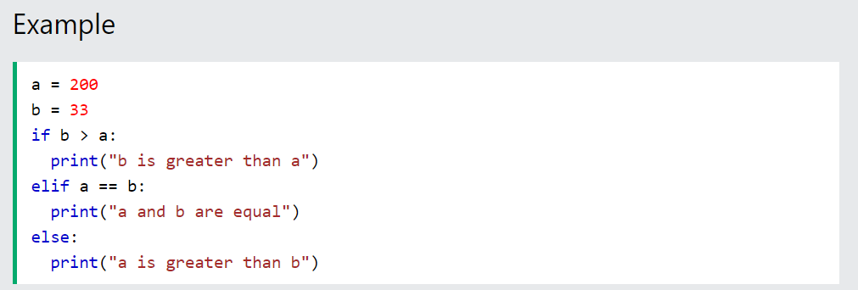
Else
The else keyword catches anything which isn't caught by the preceding conditions.
In this example a is greater than b, so the first condition is not true, also the elif condition is not true, so we go to the else condition and print to screen that "a is greater than b".

Slide 5
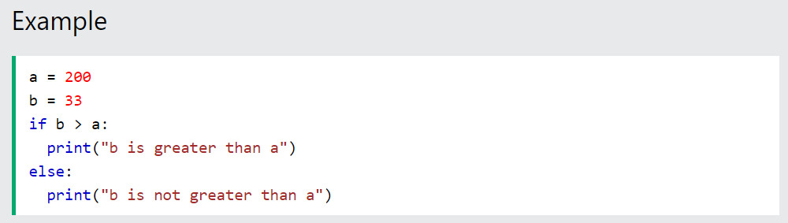
You can also have an else without the elif:

Slide 6
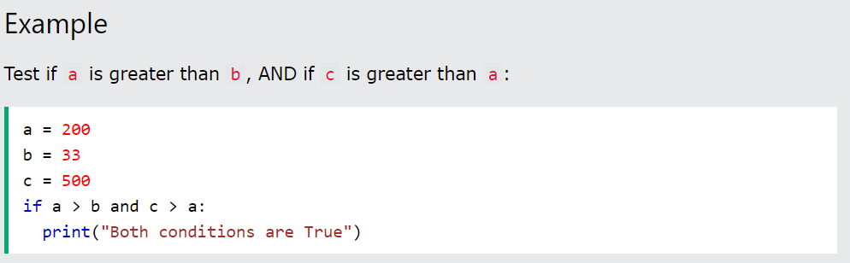
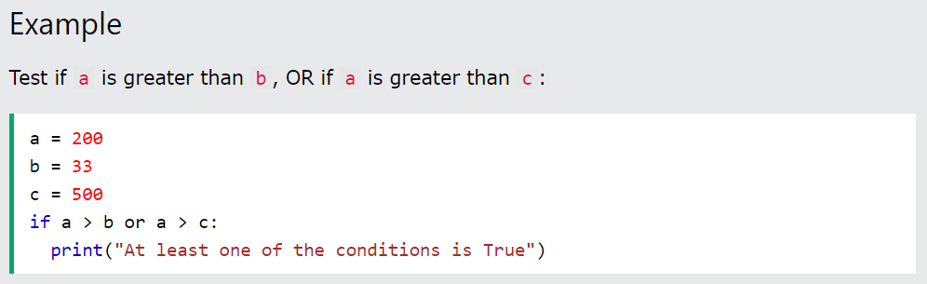
And
The and keyword is a logical operator, and is used to combine conditional statements:
Or
The or keyword is a logical operator, and is used to combine conditional statements:

Slide 7
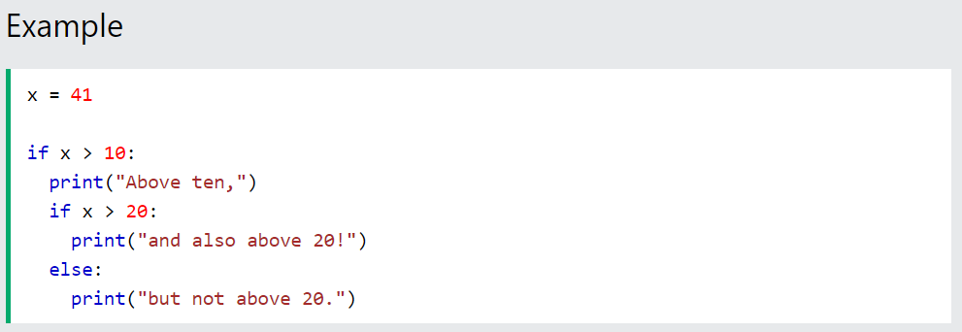
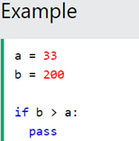
Nested If
You can have if statements inside if statements, this is called nested if statements.
The pass Statement
if statements cannot be empty, but if you for some reason have an if statement with no content, put in the pass statement to avoid getting an error.

Slide 8

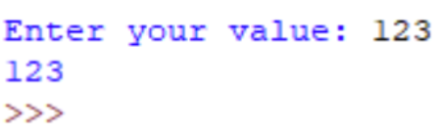
Taking input in Python
Developers often have a need to interact with users, either to get data or to provide some sort of result. Most programs today use a dialog box as a way of asking the user to provide some type of input. While Python provides us with two inbuilt functions to read the input from the keyboard.
input ( prompt )
raw_input ( prompt )
input ( ) : This function first takes the input from the user and then evaluates the expression, which means Python automatically identifies whether user entered a string or a number or list. If the input provided is not correct then either syntax error or exception is raised by python. For example –

Slide 9
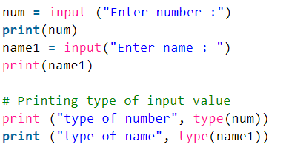
How the input function works in Python :
When input() function executes program flow will be stopped until the user has given an input.
The text or message display on the output screen to ask a user to enter input value is optional i.e. the prompt, will be printed on the screen is optional.
Whatever you enter as input, input function convert it into a string. if you enter an integer value still input() function convert it into a string. You need to explicitly convert it into an integer in your code using typecasting.

Slide 10

raw_input ( ) : This function works in older version (like Python 2.x). This function takes exactly what is typed from the keyboard, convert it to string and then return it to the variable in which we want to store. For example
Here, g is a variable which will get the string value, typed by user during the execution of program. Typing of data for the raw_input() function is terminated by enter key. We can use raw_input() to enter numeric data also

Slide 11
Taking input from console in Python
What is Console in Python? Console (also called Shell) is basically a command line interpreter that takes input from the user i.e one command at a time and interprets it. If it is error free then it runs the command and gives required output otherwise shows the error message.
Here we write command and to execute the command just press enter key and your command will be interpreted. For coding in Python you must know the basics of the console used in Python.
The primary prompt of the python console is the three greater than symbols
>>>
You are free to write the next command on the shell only when after executing the first command these prompts have appeared. The Python Console accepts command in Python which you write after the prompt.

Slide 12
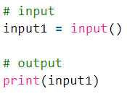
Accepting Input from Console User enters the values in the Console and that value is then used in the program as it was required. To take input from the user we make use of a built-in function input().
We can also type cast this input to integer, float or string by specifying the input() function inside the type.

Slide 13
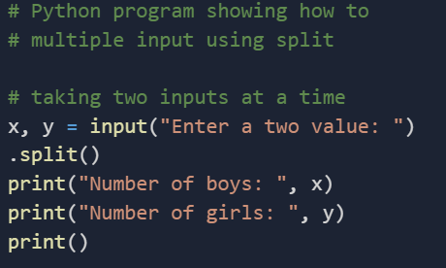

Taking multiple inputs from user in Python
In Python user can take multiple values or inputs in one line by two methods.
1.Using split() method
2.Using List comprehension
Using split() method : This function helps in getting multiple inputs from users. It breaks the given input by the specified separator. If a separator is not provided then any white space is a separator. Generally, users use a split() method to split a Python string but one can use it in taking multiple inputs.
Syntax
input().split(separator, maxsplit)
OUTPUT :

Slide 14
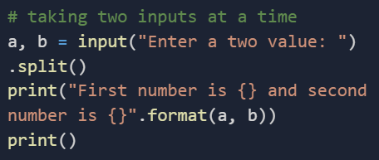

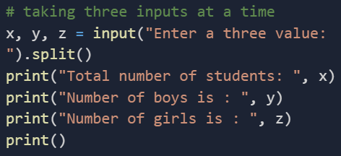
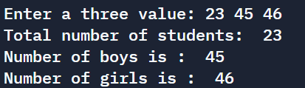
OUTPUT :
OUPUT :

Slide 15
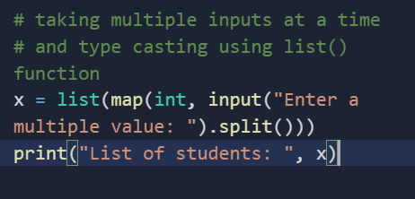
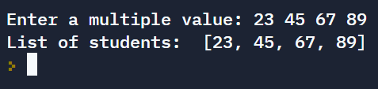
OUTPUT :

Slide 16
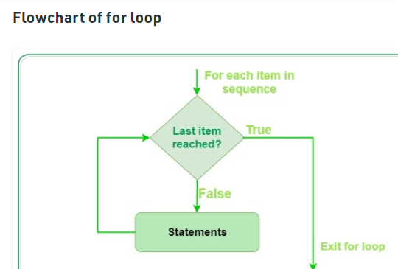
INTRODUCTION TO LOOPS
What are loops?
In computer programming, a loop is a sequence of instruction s that is continually repeated until a certain condition is reached. Typically, a certain process is done, such as getting an item of data and changing it, and then some condition is checked such as whether a counter has reached a prescribed number.
What are the 2 main types of loops in Python?
There are two types of loops in Python, for and while.

Slide 17
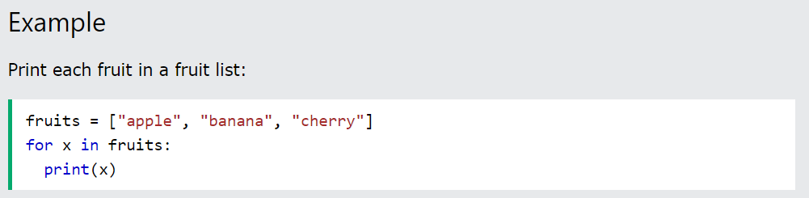
Python For Loops
A for loop is used for iterating over a sequence (that is either a list, a tuple, a dictionary, a set, or a string).
This is less like the for keyword in other programming languages, and works more like an iterator method as found in other object-orientated programming languages.
With the for loop we can execute a set of statements, once for each item in a list, tuple, set etc.
The for loop does not require an indexing variable to set beforehand.

Slide 18
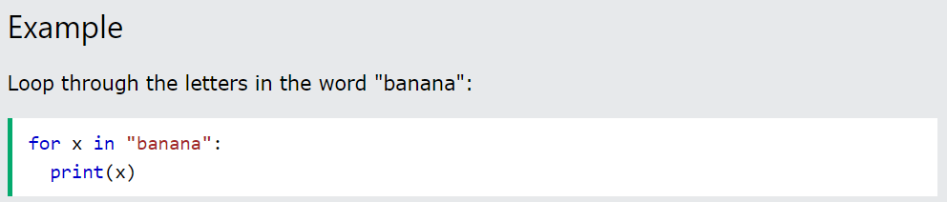
Looping Through a String
Even strings are iterable objects, they contain a sequence of characters:

Slide 19
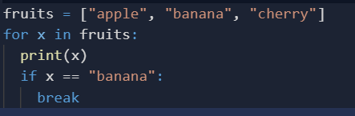
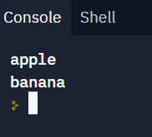
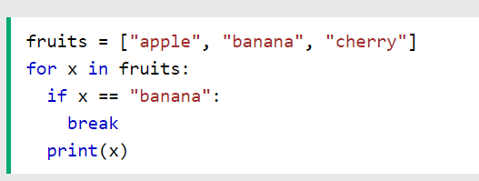
The break Statement
With the break statement we can stop the loop before it has looped through all the items:
Example
Exit the loop when x is "banana":
Example
Exit the loop when x is "banana", but this time the break comes before the print:

Slide 20
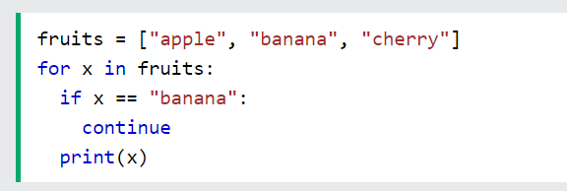
The continue Statement
With the continue statement we can stop the current iteration of the loop, and continue with the next:
Example
Do not print banana:

Slide 21
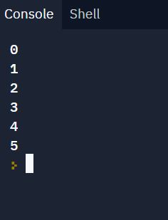

The range() Function
To loop through a set of code a specified number of times, we can use the range() function,
The range() function returns a sequence of numbers, starting from 0 by default, and increments by 1 (by default), and ends at a specified number.
Note that range(6) is not the values of 0 to 6, but the values 0 to 5.
The range() function defaults to 0 as a starting value, however it is possible to specify the starting value by adding a parameter: range(2, 6), which means values from 2 to 6 (but not including 6):

Slide 22
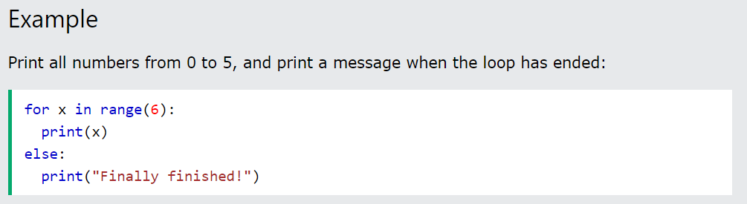
Else in For Loop
The else keyword in a for loop specifies a block of code to be executed when the loop is finished:
Note: The else block will NOT be executed if the loop is stopped by a break statement.

Slide 23
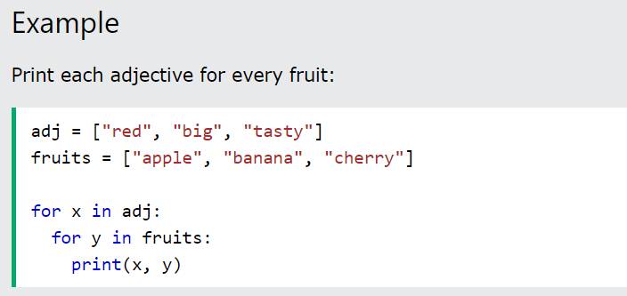
Nested Loops
A nested loop is a loop inside a loop.
The "inner loop" will be executed one time for each iteration of the "outer loop":
The pass Statement
for loops cannot be empty, but if you for some reason have a for loop with no content, put in the pass statement to avoid getting an error.

Slide 24
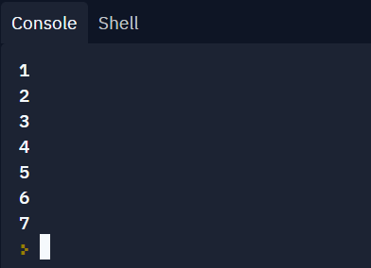
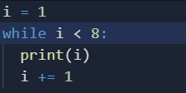
The while Loop
With the while loop we can execute a set of statements as long as a condition is true.
Note: remember to increment i, or else the loop will continue forever.
The while loop requires relevant variables to be ready, in this example we need to define an indexing variable, i, which we set to 1.

Slide 25
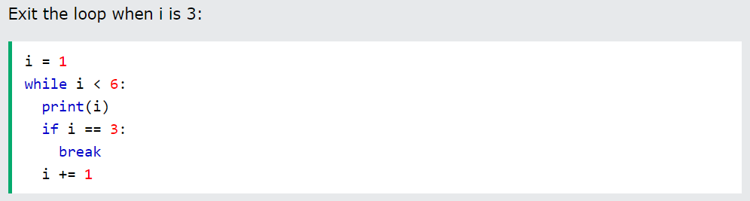
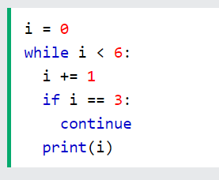
The break Statement
With the break statement we can stop the loop even if the while condition is true:
Example
The continue Statement
With the continue statement we can stop the current iteration, and continue with the next:
Example
Continue to the next iteration if i is 3:

Slide 26
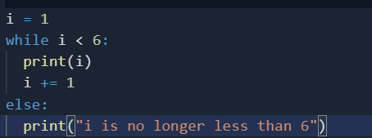
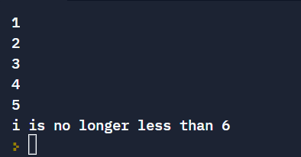
The else Statement
With the else statement we can run a block of code once when the condition no longer is true:
Example
Print a message once the condition is false:

Slide 27
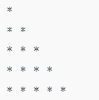
Certain questions for implementing the concept of loops
Q1. Iterate over a list in Python.
Solution :
# iterate over a list or print all elements present in a list
list = [1,2,3,4,5]
# Using for loop
For x in list:
print(i)
Q2. print the following pattern using loops in python.
n = 5
for i in range(0, n):
# inner loop to handle number of columns
# values changing acc. to outer loop
for j in range(0, i+1):
# printing stars
print("* ",end="")
# ending line after each row
print("\r")

Slide 28
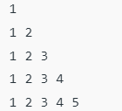
Q3 . Print the following code using loops.
Solution :
num = 1
n = 5
# outer loop to handle number of rows
for i in range(0, n):
# re assigning num
num = 1
# inner loop to handle number of columns
# values changing acc. to outer loop
for j in range(0, i+1):
# printing number
print(num, end=" ")
# incrementing number at each column
num = num + 1
# ending line after each row
print("\r")

Slide 29
Thankyou

